Slide 1
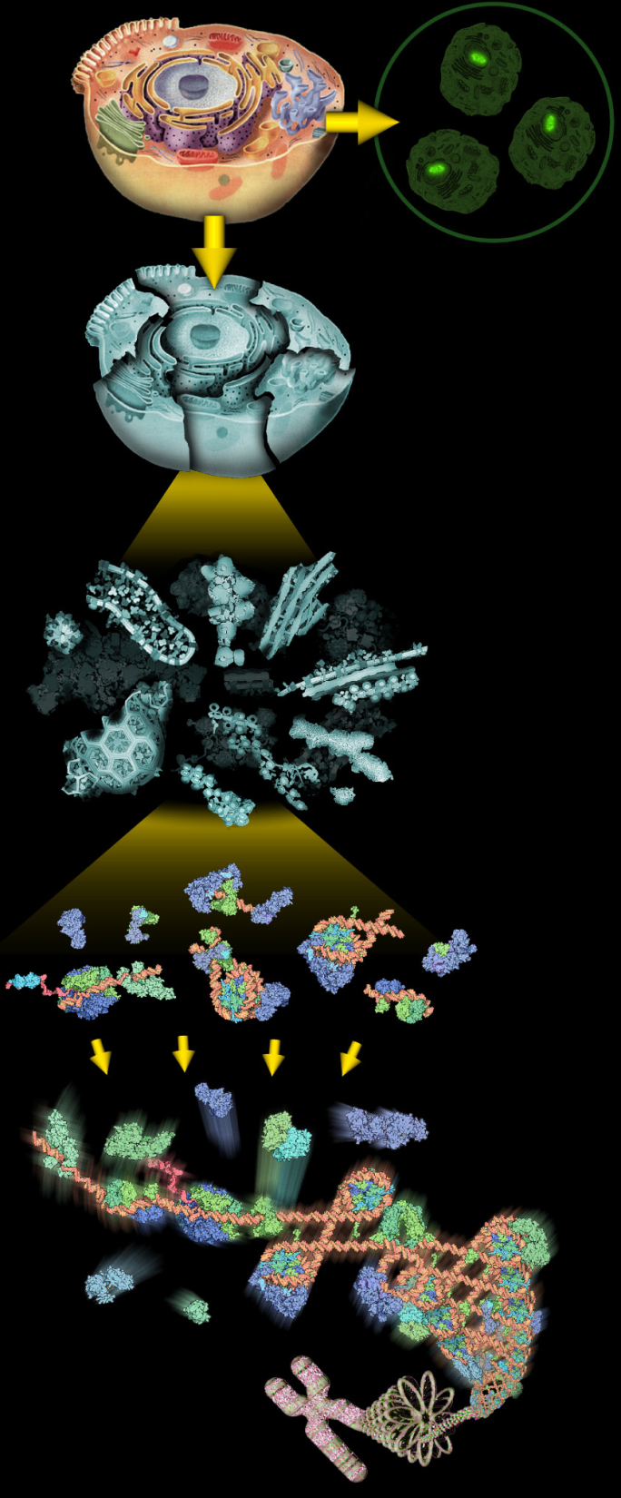
Proteomics Informatics Workshop
Part I: Protein Identification
David Fenyö
February 4, 2011
Introduction to proteomics
Introduction to mass spectrometry
Analysis of mass spectra
Database searching
Spectrum library searching
de novo sequencing
Significance testing

Slide 2
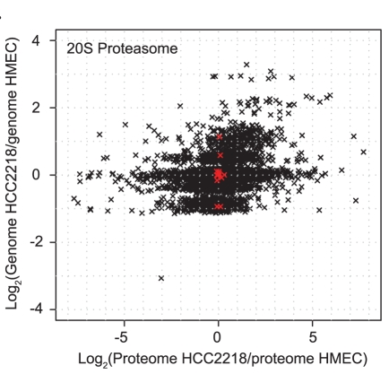
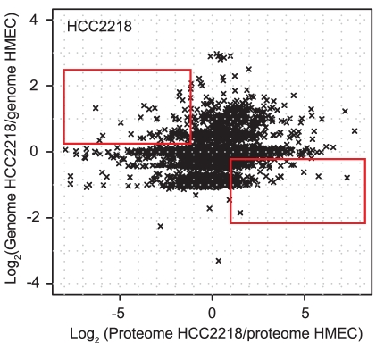
Why Proteomics?
Geiger et al., “Proteomic changes resulting from gene copy number variations in cancer cells”, PLoS Genet. 2010 Sep 2;6(9). pii: e1001090.

Slide 3
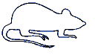
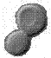
Proteomics Informatics
Biological System
Experimental
Design
Samples
Sample
Preparation
MS/MS
MS
Measurements
Data Analysis
Data Analysis
What does the
sample contain?
How much?
What does the
sample contain?
How much?
Information about each sample
Information
Integration
Information about the biological system

Slide 4
Sample Preparation
Biological System
Experimental
Design
Samples
Enrichment
Separation etc
Sample
Preparation
MS/MS
Digestion
MS
Measurements
Top
down
Bottom
up
Data Analysis
What does the
sample contain?
How much?
What does the
sample contain?
How much?
Information about each sample
Information
Integration
Information about the biological system

Slide 5
Mass Spectrometry (MS)
Ion Source
Mass Analyzer
Detector
MALDI
ESI
Quadrupole
Ion Trap (3D, linear)
Time-of-Flight
Orbitrap
FTICR
intensity
mass/charge

Slide 6
Mass Spectrometry – MALDI-TOF
Ion Source
Mass Analyzer
Detector
MALDI
Time-of-Flight
Detector
HV
Ion mirror
Laser
Detector

Slide 7
Tandem Mass Spectrometry (MS/MS)
Ion Source
Detector
CAD – Collision
Activated
Dissociation
Mass Analyzer 1
Frag-mentation
Mass Analyzer 2
Quadrupole
Quadrupole
Quadrupole
m/z
m/z
NO
m/z
time
time
intensity
time
m/z
m/z
YES
m/z
time
time
mass/charge
time
m/z
m/z
YES
m/z
time
time
time
Δm/z is constant

Slide 8
Dissociation Techniques
CAD: Collision Activated Dissociation (b, y ions)
⇒ increase of internal energy through collisions
ETD: Electron Transfer Dissociation (c, z ions)
⇒ radical driven fragmentation

Slide 9
Dissociation Techniques: CAD versus ETD
CAD
Low charge
Short peptides
Weakest bonds
break first
Preferred cleavage
N-terminal to proline
ETD
High charge
Up to intact proteins
More uniform fragmentation
No cleavage
N-terminal to proline

Slide 10
Liquid Chromatography (LC)-MS/MS
LC
Ion Source
Mass Analyzer 1
Frag-mentation
Mass Analyzer 2
Detector
intensity
intensity
intensity
intensity
intensity
intensity
intensity
intensity
intensity
intensity
intensity
intensity
intensity
intensity
intensity
mass/charge
mass/charge
mass/charge
mass/charge
mass/charge
mass/charge
mass/charge
mass/charge
mass/charge
mass/charge
mass/charge
mass/charge
mass/charge
mass/charge
mass/charge
Time

Slide 11
Data Independent Acquisistion
MS
MS/MS 1
MS/MS 2
MS/MS 3
MS
MS/MS 1
MS/MS 2
MS/MS 3
MS
MS/MS 1
MS/MS 2
MS/MS 3
MS
MS/MS 1
MS/MS 2
MS/MS 3
MS
MS/MS 1
MS/MS 2
MS/MS 3
MS
MS/MS 1
MS/MS 2
MS/MS 3
…
intensity
mass/charge
intensity
mass/charge
intensity
mass/charge
intensity
mass/charge
intensity
mass/charge
intensity
mass/charge

Slide 12
Data Dependent Acquisistion
MS
MS/MS 1
MS/MS 2
MS/MS 3
MS/MS 4
MS/MS 5
MS/MS 6
MS/MS 7
MS/MS 8
MS/MS 9
MS/MS 10
MS
MS/MS 1
MS/MS 2
MS/MS 3
MS/MS 4
MS/MS 5
MS/MS 6
MS/MS 7
MS/MS 8
MS/MS 9
MS/MS 10
…
intensity
mass/charge
intensity
mass/charge

Slide 13
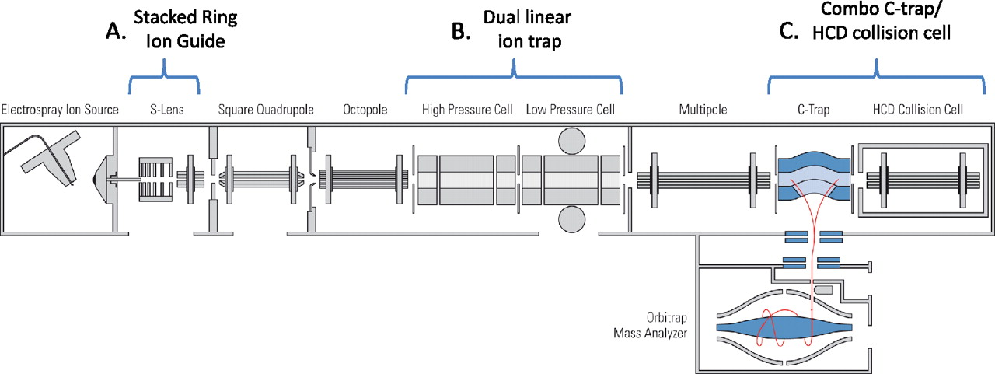
Mass Spectrometry – ESI-LC-MS/MS
ESI
Linear Ion Trap
HCD
Ion Source
Mass Analyzer 1
Frag-mentation
CAD
ETD
Detector
Frag-mentation
Mass Analyzer 2
Detector
Orbitrap
Olsen J V et al. Mol Cell Proteomics 2009;8:2759-2769

Slide 14
Charge-State Distributions
MALDI
ESI
1+
2+
Peptide
intensity
intensity
3+
2+
4+
1+
mass/charge
mass/charge
M - molecular mass
n - number of charges
H – mass of a proton
MALDI
ESI
2+
3+
1+
27+
Protein
31+
intensity
4+
intensity
5+
mass/charge
mass/charge

Slide 15
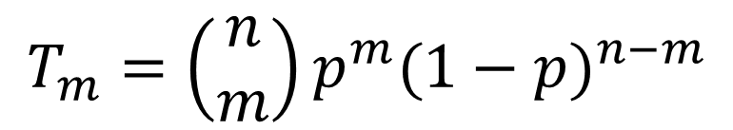
Isotope Distributions
¹²C
¹⁴N
¹⁶O
¹H
³²S
Intensity
+1Da
+2Da
+3Da
m/z
m/z
m/z
0.015% ²H
1.11% ¹³C
0.366% ¹⁵N
0.038% ¹⁷O, 0.200% ¹⁸O,
0.75% ³³S, 4.21% ³⁴S, 0.02% ³⁶S
Only ¹²C and ¹³C:
p=0.0111
n is the number of C in the peptide
m is the number of ¹³C in the peptide
T_{m} is the relative intensity of
the peptide m ¹³C
$$T_{m}=\left(\begin{matrix}n \\ m\end{matrix}\right)p^{m}{(1−p)}^{n−m}$$

Slide 16
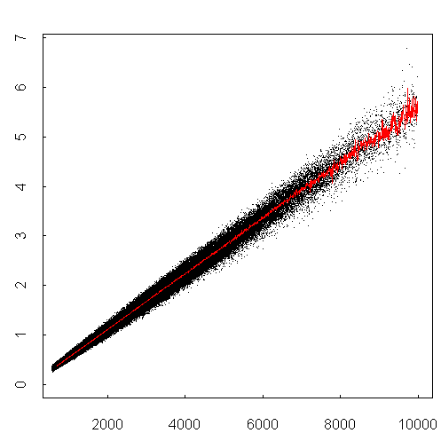
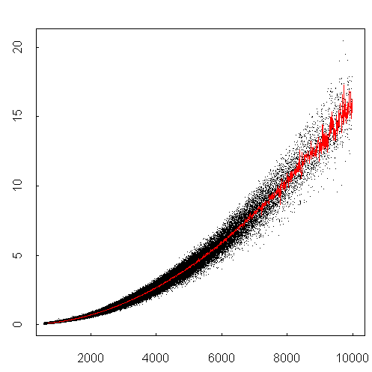
Isotope distributions
Intensity ratio
Intensity ratio
Peptide mass
Peptide mass
GFP 29kDa
monoisotopic
mass
m/z

Slide 17
Noise
Intensity
m/z

Slide 18
Peak Finding
Find maxima of
Intensity
The signal in a peak can be
estimated with the RMSD
m/z
and the signal-to-noise ratio of a peak
can be estimated by dividing the signal
with the RMSD of the background
The centroid m/z of a peak

Slide 19
Isotope Clusters and Charge State
0.33
0.5
1
1+
3+
2+
Possible to
Determine Charge?
Yes
Yes
Maybe
No
0.33
0.5
Intensity
1
0.33
0.5
1
m/z

Slide 20
Identification – Peptide Mass Fingerprinting
Lysis
Fractionation
Digestion
Mass spectrometry
MS
Identified Proteins

Slide 21
Example data – Peptide Mapping by MALDI-TOF

Slide 22
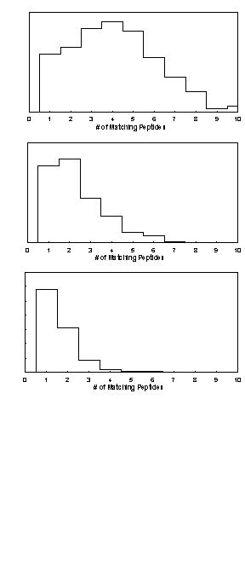
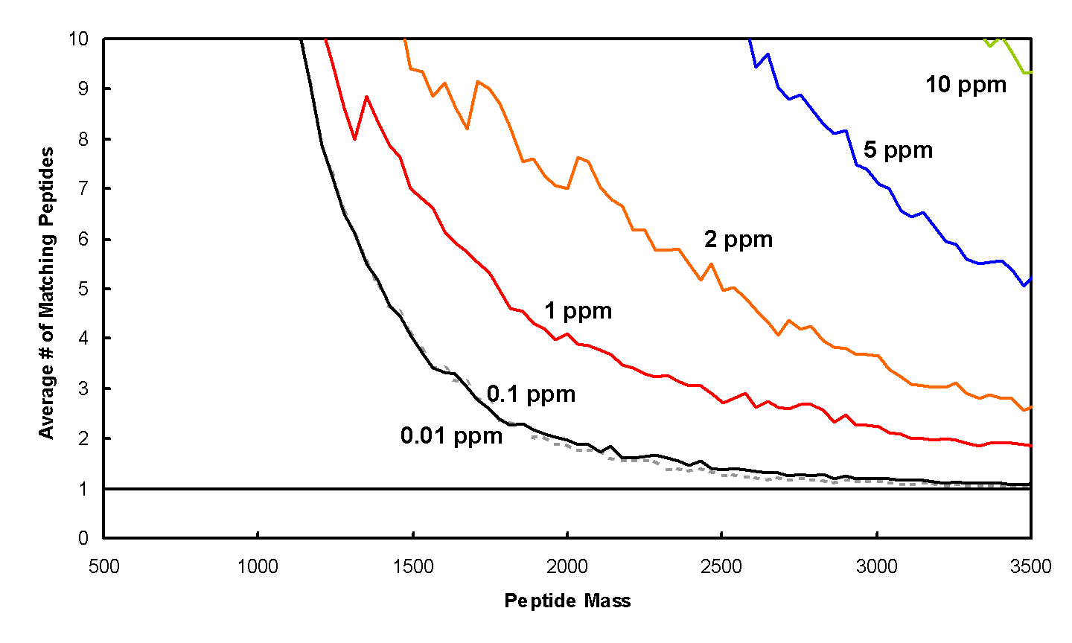
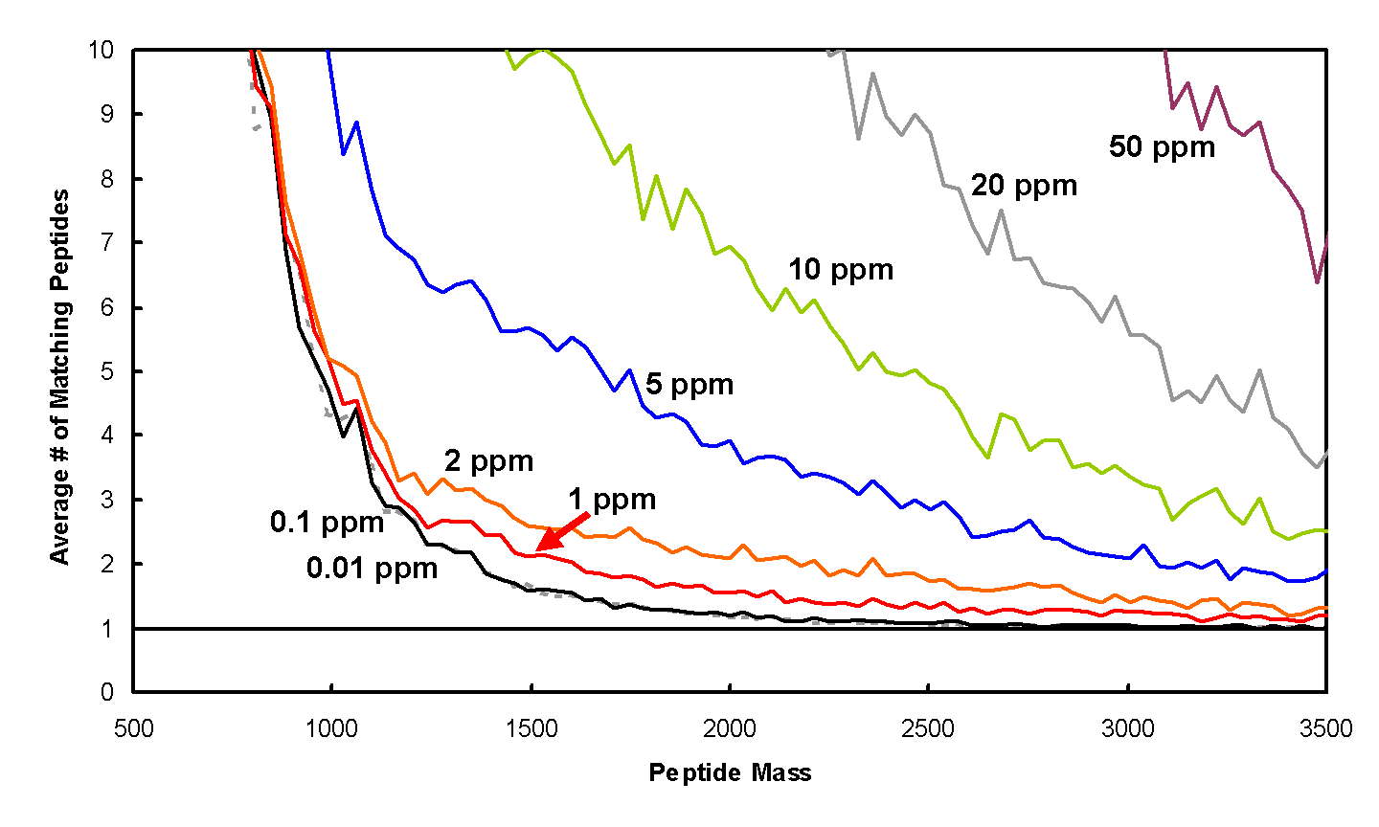
Information Content in a Single Mass Measurement
Human
10
8
6
Avg. #of matching peptides
4
3
2
1 2 3 4 6 8 10
1
#of matching peptides
1000 2000 3000
Tryptic peptide mass [Da]
S. cerevisiae
10
8
6
Avg. #of matching peptides
4
3
2
1 2 3 4 6 8 10
1
#of matching peptides
1000 2000 3000
Tryptic peptide mass [Da]

Slide 23
Identification – Peptide Mass Fingerprinting
Lysis
Fractionation
Digestion
Mass spectrometry
Peak Finding
Charge determination
De-isotoping
Searching
MS
Identified Proteins

Slide 24
Identification – Peptide Mass Fingerprinting
Sequence
DB
Pick Protein
Digestion
MS
All Peptide
Masses
Repeat for each protein
MS
Compare, Score, Test Significance
Identified Proteins

Slide 25
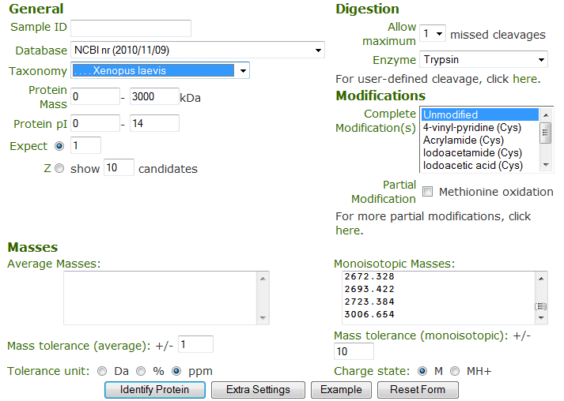
ProFound – Search Parameters
http://prowl.rockefeller.edu/

Slide 26
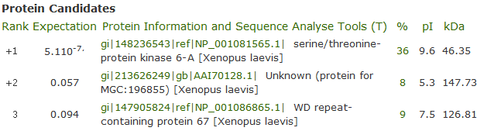
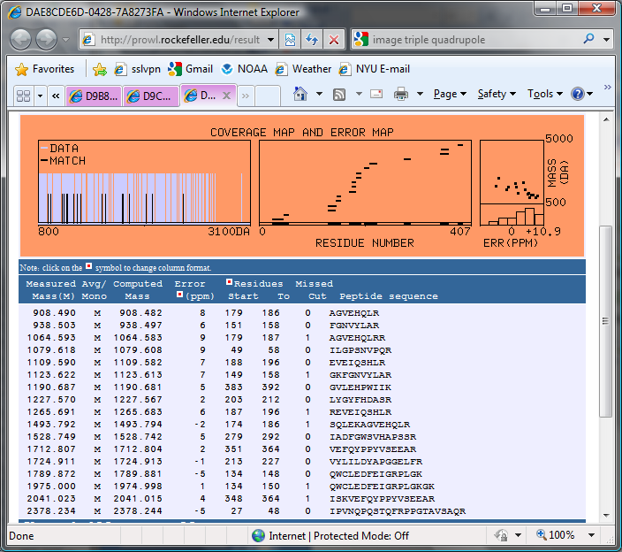
ProFound Results

Slide 27
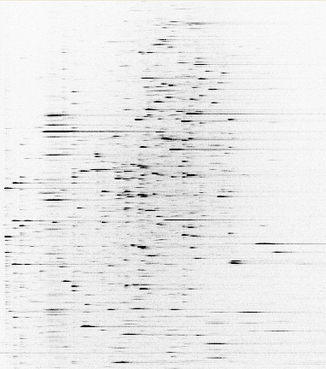
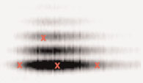
Example data – ESI-LC-MS/MS
m/z
762
MS/MS
100
875
[M+2H]²⁺
% Relative Abundance
292
633
260
405
534
1022
389
504
907
1020
663
778
1080
0
250
500
750
1000
m/z
Time

Slide 28
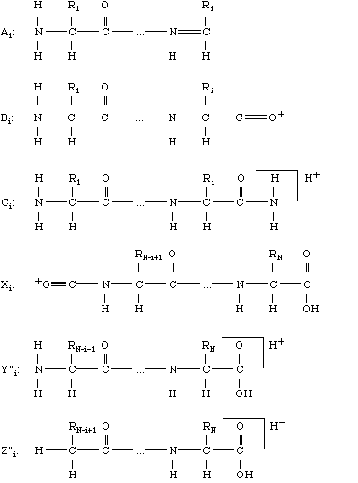
Peptide Fragmentation
Ion Source
Mass Analyzer 1
Frag-mentation
Mass Analyzer 2
Detector
b
y

Slide 29
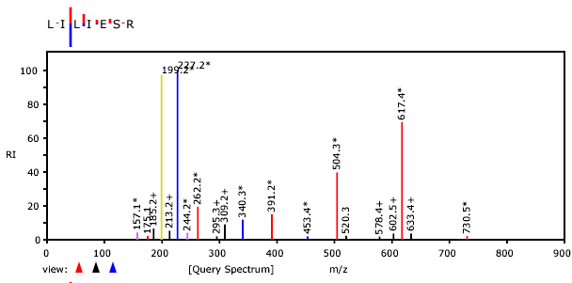
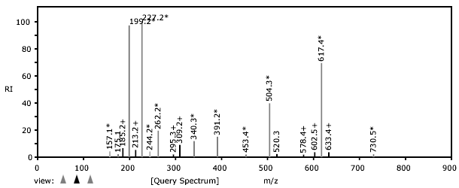
Identification – Tandem MS

Slide 30
Tandem MS – Sequence Confirmation
S
G
F
L
E
E
D
E
L
K
100
% Relative Abundance
0
250
500
750
1000
m/z

Slide 31
Tandem MS – Sequence Confirmation
S
G
F
L
E
E
D
E
L
K
88
145
292
405
534
663
778
907
1020
1166
b ions
S
G
F
L
E
E
D
E
L
K
100
% Relative Abundance
0
250
500
750
1000
m/z

Slide 32
Tandem MS – Sequence Confirmation
S
G
F
L
E
E
D
E
L
K
88
145
292
405
534
663
778
907
1020
1166
b ions
S
G
F
L
E
E
D
E
L
K
1166
1080
1022
875
762
633
504
389
260
147
y ions
100
% Relative Abundance
0
250
500
750
1000
m/z

Slide 33
Tandem MS – Sequence Confirmation
S
G
F
L
E
E
D
E
L
K
88
145
292
405
534
663
778
907
1020
1166
b ions
S
G
F
L
E
E
D
E
L
K
1166
1080
1022
875
762
633
504
389
260
147
y ions
762
100
875
[M+2H]²⁺
% Relative Abundance
633
292
405
534
260
389
1022
504
907
1020
663
778
1080
0
250
500
750
1000
m/z

Slide 34
Tandem MS – Sequence Confirmation
S
G
F
L
E
E
D
E
L
K
88
145
292
405
534
663
778
907
1020
1166
b ions
S
G
F
L
E
E
D
E
L
K
1166
1080
1022
875
762
633
504
389
260
147
y ions
762
100
875
[M+2H]²⁺
% Relative Abundance
633
292
405
534
260
389
1022
504
907
1020
663
778
1080
0
250
500
750
1000
m/z

Slide 35
Tandem MS – Sequence Confirmation
S
G
F
L
E
E
D
E
L
K
88
145
292
405
534
663
778
907
1020
1166
b ions
S
G
F
L
E
E
D
E
L
K
1166
1080
1022
875
762
633
504
389
260
147
y ions
762
100
875
[M+2H]²⁺
113
113
% Relative Abundance
633
292
405
534
260
389
1022
504
907
1020
663
778
1080
0
250
500
750
1000
m/z

Slide 36
Tandem MS – Sequence Confirmation
S
G
F
L
E
E
D
E
L
K
88
145
292
405
534
663
778
907
1020
1166
b ions
S
G
F
L
E
E
D
E
L
K
1166
1080
1022
875
762
633
504
389
260
147
y ions
762
100
129
875
[M+2H]²⁺
% Relative Abundance
129
633
292
405
534
260
389
1022
504
907
1020
663
778
1080
0
250
500
750
1000
m/z

Slide 37
Tandem MS – Sequence Confirmation
S
G
F
L
E
E
D
E
L
K
88
145
292
405
534
663
778
907
1020
1166
b ions
S
G
F
L
E
E
D
E
L
K
1166
1080
1022
875
762
633
504
389
260
147
y ions
762
100
875
[M+2H]²⁺
% Relative Abundance
633
292
405
534
260
389
1022
504
907
1020
663
778
1080
0
250
500
750
1000
m/z

Slide 38
Tandem MS – Sequence Confirmation
S
G
F
L
E
E
D
E
L
K
88
145
292
405
534
663
778
907
1020
1166
b ions
S
G
F
L
E
E
D
E
L
K
1166
1080
1022
875
762
633
504
389
260
147
y ions
762
100
875
[M+2H]²⁺
% Relative Abundance
633
292
405
534
260
389
1022
504
907
1020
663
778
1080
0
250
500
750
1000
m/z

Slide 39
Tandem MS – Sequence Confirmation
S
G
F
L
E
E
D
E
L
K
88
145
292
405
534
663
778
907
1020
1166
b ions
S
G
F
L
E
E
D
E
L
K
1166
1080
1022
875
762
633
504
389
260
147
y ions
762
100
875
[M+2H]²⁺
% Relative Abundance
633
292
405
534
260
389
1022
504
907
1020
663
778
1080
0
250
500
750
1000
m/z

Slide 40
Tandem MS – de novo Sequencing
762
100
Amino acid masses
875
[M+2H]²⁺
% Relative Abundance
292
633
260
405
534
1022
389
504
907
1020
663
778
1080
0
250
500
750
1000
m/z
Mass Differences
Sequences
consistent
with spectrum

Slide 41
Tandem MS – de novo Sequencing

Slide 42
Tandem MS – de novo Sequencing

Slide 43
Tandem MS – de novo Sequencing
X
X
X
SGF(I/L)EEDE(I/L)…
1166 – 1020 – 18 = 128
K or Q
SGF(I/L)EEDE(I/L)(K/Q)
…GF(I/L)EEDE(I/L)…
…(I/L)EDEE(I/L)FG…
…GF(I/L)EEDE(I/L)…
…(I/L)EDEE(I/L)FG…
Peptide M+H = 1166
1166 -1079 = 87 => S
SGF(I/L)EEDE(I/L)…
X
X
X

Slide 44
Tandem MS – de novo Sequencing
Challenges in de novo sequencing
Neutral loss (-H₂O, -NH₃)
Modifications
Background peaks
Incomplete information
Challenges in de novo sequencing
Neutral loss (-H₂O, -NH₃)
Modifications
Background peaks
Incomplete information

Slide 45
Tandem MS – Database Search
Sequence
DB
Lysis
Fractionation
Pick Protein
Digestion
LC-MS
Pick Peptide
MS/MS
Repeat for all proteins
All Fragment
Masses
Repeat for
all peptides
MS/MS
Compare, Score, Test Significance

Slide 46
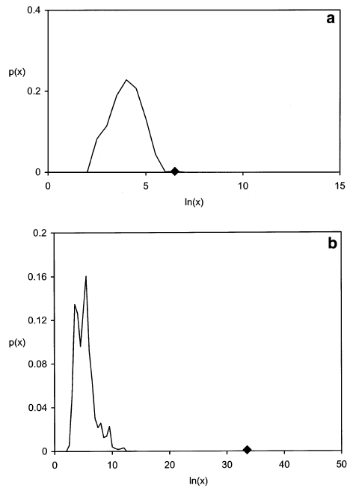
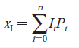
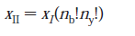
Tandem MS – Database Search

Slide 47
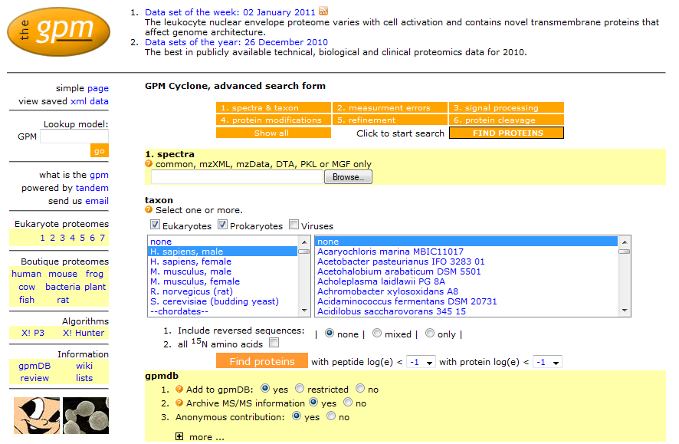
X! Tandem - Search Parameters
http://www.thegpm.org/

Slide 48
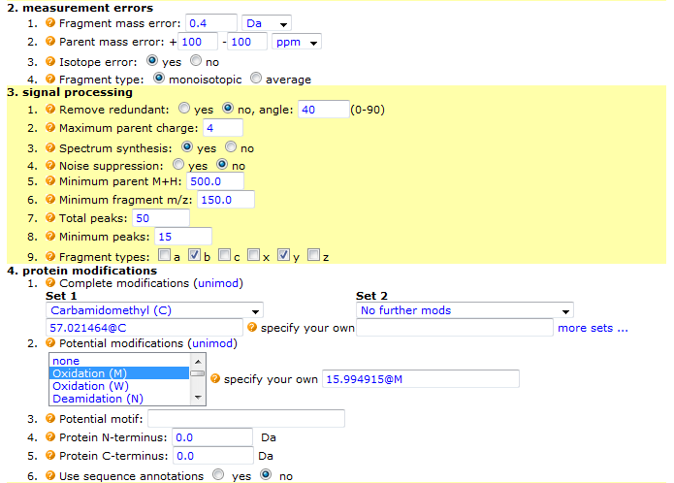
X! Tandem - Search Parameters

Slide 49
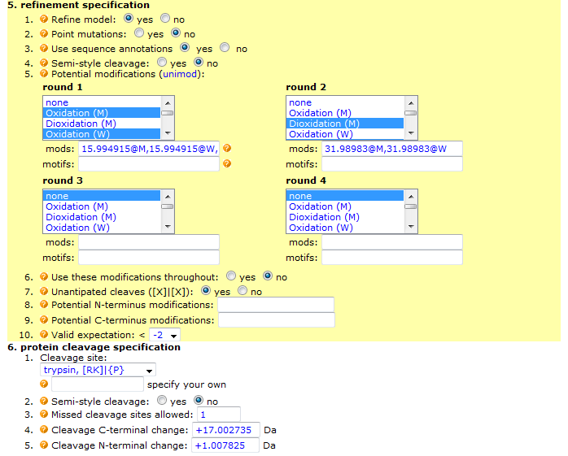
X! Tandem - Search Parameters

Slide 50
Multi-stage searching
spectra
Tryptic
cleavage
Modifications #1
sequences
Modifications #2
sequences
Point mutation
X! Tandem

Slide 51
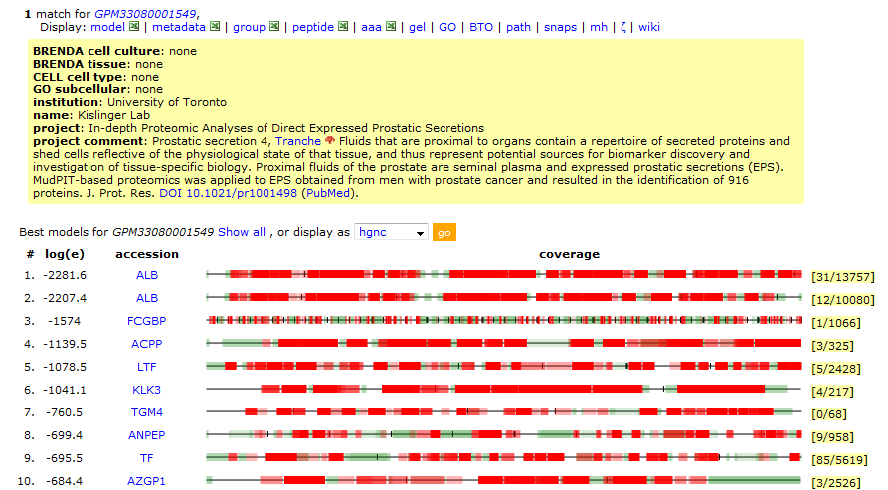
Search Results

Slide 52
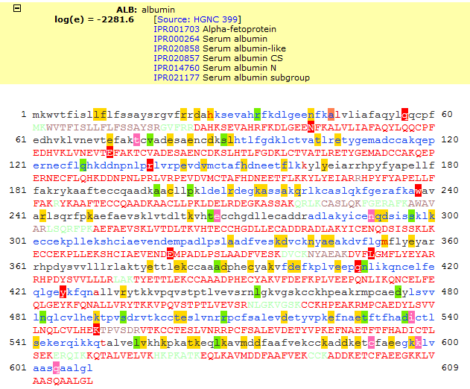
Search Results

Slide 53
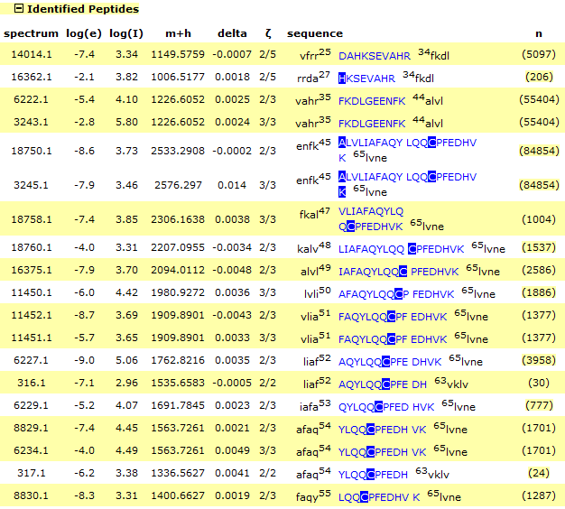
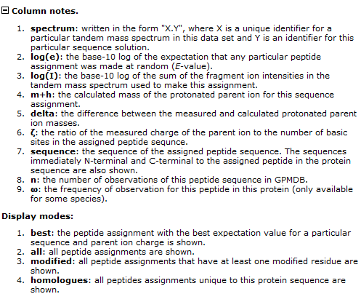
Search Results

Slide 54
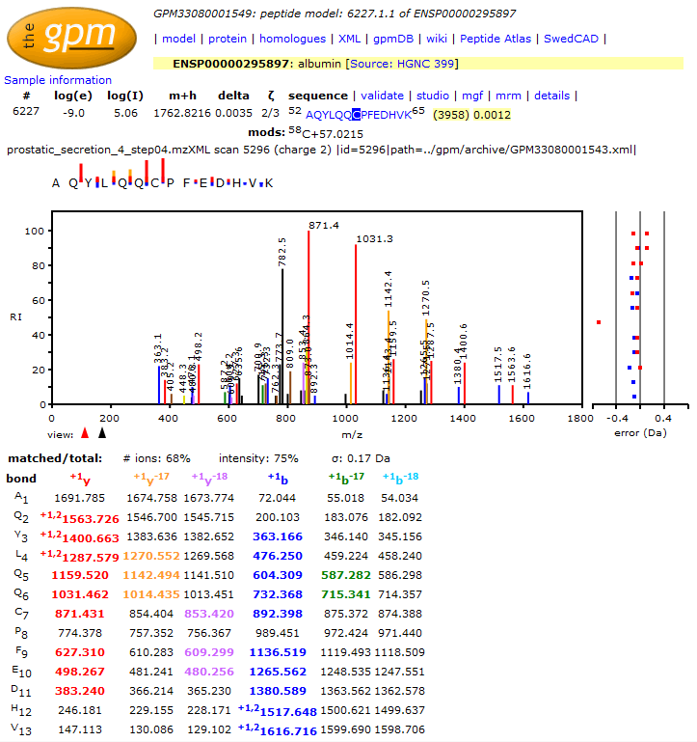
Search Results

Slide 55
How many fragment masses
are needed for identification?
1
Critical # of Matching Fragments
16
Probability of Identification
0.5
8
Critical # of
Matching
Fragments
Critical # of
Matching
Fragments
0
0
5
10
15
A parameter
Number of Matching Fragments

Slide 56
Small peptides are slightly more difficult to identify
m_{precursor}
Δm_{precursor} = 1 Da
Δm_{fragment} = 0.5 Da
No modification

Slide 57
A lower precursor mass error
requires fewer fragment masses for
identification of unmodified peptides
m_{precursor} = 2000 Da
Δm_{fragment} = 0.5 Da
No modification

Slide 58
The dependence on the fragment mass error is weak below a threshold for identification of unmodified peptides
Δm_{fragment}
m_{precursor} = 2000 Da
Δm_{precursor} = 1 Da
No modification

Slide 59
A moderate number of background peaks can be tolerated when identifying unmodified peptides
Background
m_{precursor} = 2000 Da
Δm_{precursor} = 1 Da
Δm_{fragment} = 0.5 Da
No modification

Slide 60
A large number of background peaks can be tolerated if the fragment mass is accurate
Background
m_{precursor} = 2000 Da
Δm_{precursor} = 1 Da
Δm_{fragment} = 0.01 Da
No modification

Slide 61
Identification of phosphopeptides
is only slightly more difficult
m_{precursor} = 2000 Da
Δm_{precursor} = 1 Da
Δm_{fragment} = 0.5 Da

Slide 62
Identification – Spectrum Library Search
Spectrum
Library
Lysis
Fractionation
Digestion
LC-MS/MS
Pick
Spectrum
Repeat for
all spectra
MS/MS
Compare, Score, Test Significance
Identified Proteins

Slide 63
Spectrum Library Characteristics – Peptide Length

Slide 64
Spectrum Library Characteristics – Protein Coverage

Slide 65
Spectrum Library Characteristics – Size
Species | Spectra | Peptides | Redundancy
H. sapiens | 1002326 | 270345 | ×3.7
P. troglodytes | 889232 | 238688 | ×3.7
M. mulata | 754601 | 195701 | ×3.9
M. musculus | 732382 | 199182 | ×3.7
R. norvegicus | 637776 | 160439 | ×4.0
B. taurus | 592070 | 140063 | ×4.2
E. caballus | 590514 | 139849 | ×4.2
S. cerevisiae | 201253 | 133166 | ×1.5
C. elegans | 190952 | 90981 | ×2.1
D. rerio | 174049 | 46546 | ×3.7
T. rubripes | 169551 | 36514 | ×4.6
D. melanogaster | 122353 | 71928 | ×1.7
A. thaliana | 111689 | 62574 | ×1.8

Slide 66
Identification – Spectrum Library Search
Library spectrum
(5:25)
Test spectrum
(5:25)
Results: 4 peaks selected, 1 peak missed

Slide 67
Identification – Spectrum Library Search
How likely is this?
Apply a hypergeometric probability model:
- 25 possible m/z values;
- 5 peaks in the library spectrum; and
- 4 selected by the test spectrum.
Matches | Probability
1 | 0.45
2 | 0.15
3 | 0.016
4 | 0.00039
5 | 0.0000037

Slide 68
Identification – Spectrum Library Search
If you have 1000 possible m/z values and 20 peaks in test and library spectrum?
1 matched: p = 0.6
5 matched: p = 0.0002
10 matched: p = 0.0000000000001

Slide 69
Identification – Spectrum Library Search
Library of Assigned
Mass Spectra
Experimental
Mass Spectrum
☹
✓
M/Z
Best search result

Slide 70

X! Hunter Result
Query Spectrum
Library Spectrum

Slide 71
Significance Testing
False protein identification is caused by random matching
An objective criterion for testing the significance of protein identification results is necessary.
The significance of protein identifications can be tested once the distribution of scores for false results is known.

Slide 72
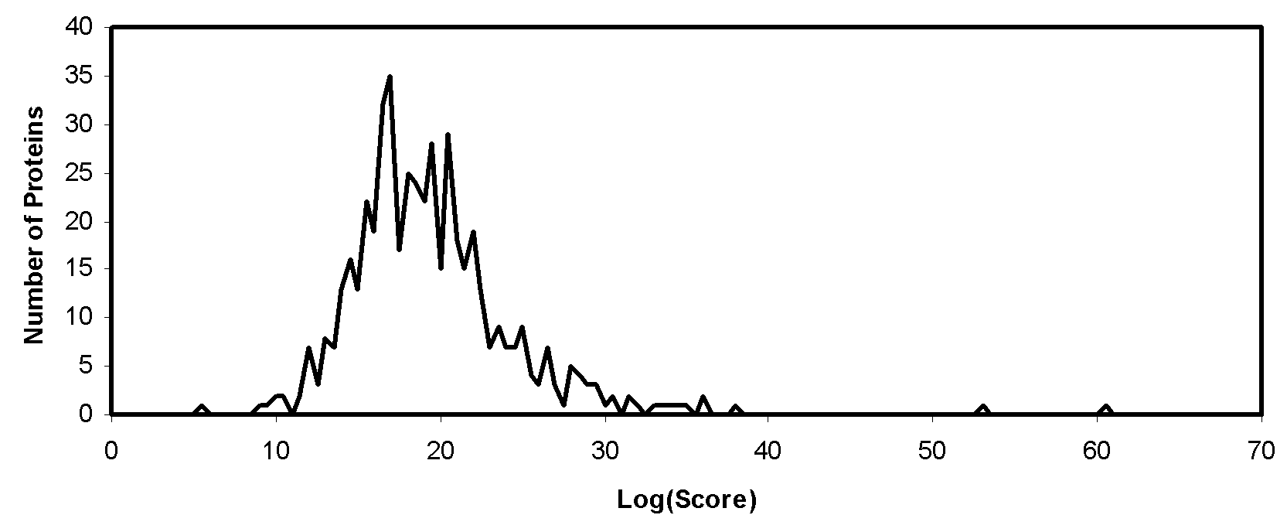
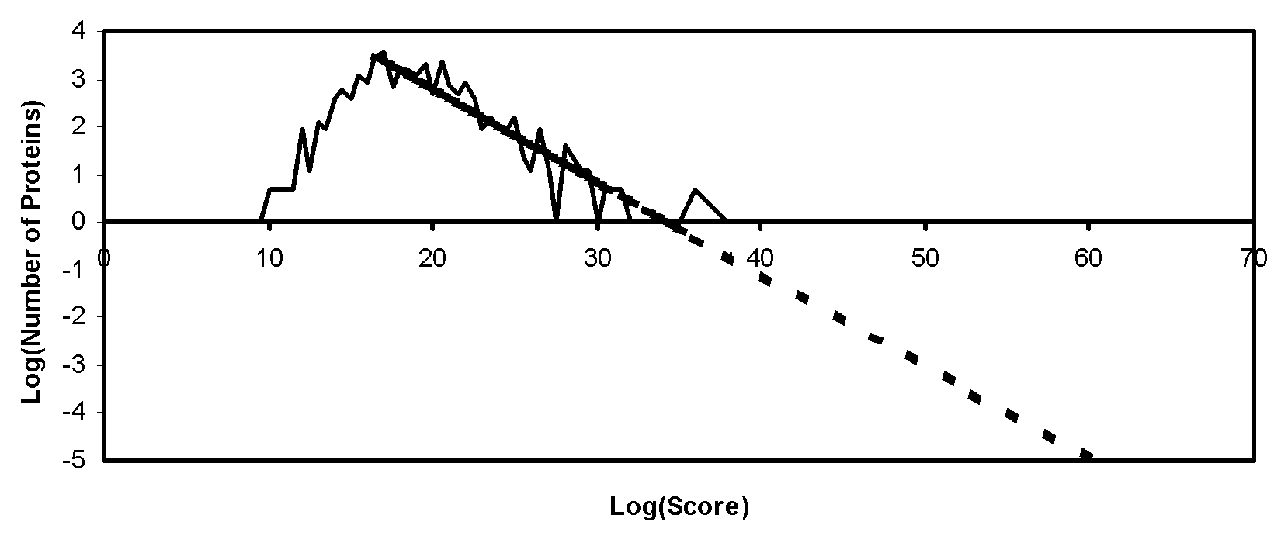
Significance Testing - Expectation Values
The majority of sequences in a collection will give a score due to random matching.

Slide 73
Significance Testing - Expectation Values
Database Search
List of Candidates
M/Z
Distribution of Scores
for Random and False
Identifications
Extrapolate
And Calculate
Expectation Values
List of Candidates With Expectation Values

Slide 74
Rho-diagrams: Overall Quality of a Data Set
Expectation values as a function of score for random matching:
Definition: E_{i} (i=0,-1,-2,…) is the number of spectra that has been assigned an expectation value between exp(i) and exp(i-1). For random matching:

Slide 75
Rho-diagram
Random Matching

Slide 76
Rho-diagram
Data Quality

Slide 77
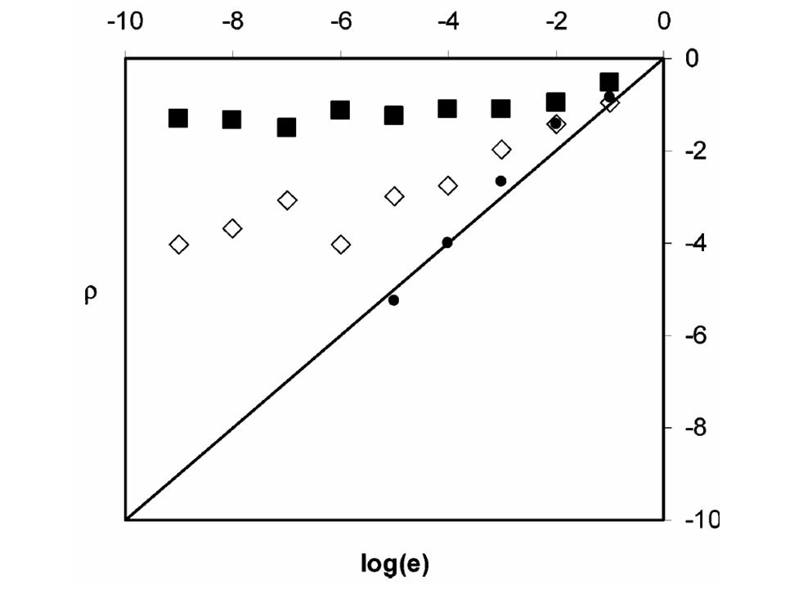
Rho-diagram
Parameters

Slide 78
Summary
Protein identification strategies:
- de Novo Sequencing
- Searching Sequence Collections
- Searching Spectrum Libraries
It is important to report the significance of the results

Slide 79
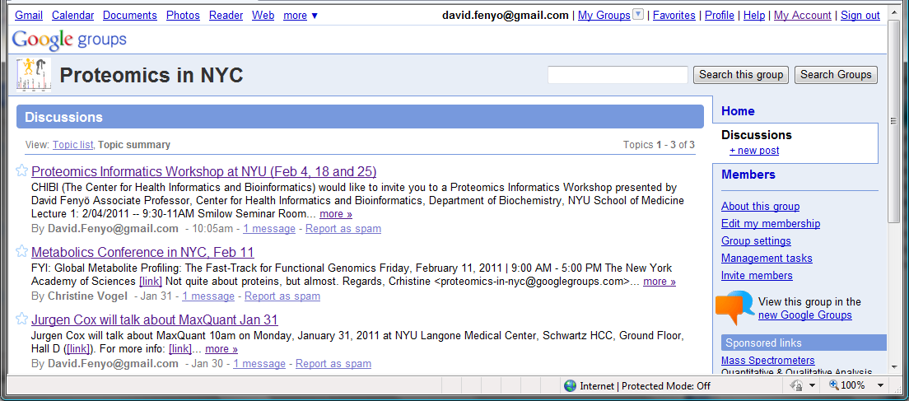
Google Group for Proteomics in NYC
Please join!

Slide 80
Proteomics Informatics Workshop
Part II: Protein Characterization
February 18, 2011
Top-down/bottom-up proteomics
Post-translational modifications
Protein complexes
Cross-linking
The Global Proteome Machine Database

Slide 81
Proteomics Informatics Workshop
Part III: Protein Quantitation
February 25, 2011
Metabolic labeling – SILAC
Chemical labeling
Label-free quantitation
Spectrum counting
Stoichiometry
Protein processing and degradation
Biomarker discovery and verification

Slide 82
Proteomics Informatics Workshop
Part I: Protein Identification, February 4, 2011
Part II: Protein Characterization, February 18, 2011
Part III: Protein Quantitation, February 25, 2011

